Slide 1
Applications of Propositional Logic (PL)

Slide 2
Domain of PL application
Specification of software and hardware,
Design of computer circuits,
Construct computer programs,
Verify the correctness of programs
To build expert systems

Slide 3
System Specifications
Translating sentences in natural language (such as English) into logical expressions
It is essential of specifying both hardware and software systems.
Software engineers produce precise and unambiguous specifications that can be used as the basis for system development.
Example: Express the specification “The automated reply cannot be sent when the file system is full” using logical connectives.
Solution: Let P: “The automated reply can be sent”
q: “The file system is full”
specification: q → ¬p.

Slide 4
Consistency:
System specifications should be consistent, that is, they should not contain conflicting requirements that could be used to derive a contradiction.
Example:
Determine whether these system specifications are consistent:
“The diagnostic message is stored in the buffer or it is retransmitted.”
“The diagnostic message is not stored in the buffer.”
“If the diagnostic message is stored in the buffer, then it is retransmitted.”
Solution:
Let p: “The diagnostic message is stored in the buffer” and q: “The diagnostic message is retransmitted.”
The specifications can then be written as p ∨ q, ¬p, and p → q.
An assignment of truth values that makes all three specifications true must have p false to make ¬p true. Because, we want p ∨ q to be true but p must be false, q must be true. Because p → q is true when p is false and q is true,
we conclude that these specifications are consistent, because they are all true when p is false and q is true

Slide 5
Cont..
Example:
Determine whether these system specifications are consistent:
“The diagnostic message is stored in the buffer or it is retransmitted.”
“The diagnostic message is not stored in the buffer.”
“If the diagnostic message is stored in the buffer, then it is retransmitted.”
“The diagnostic message is not retransmitted.”
Solution:
Let p: “The diagnostic message is stored in the buffer” and
q: “The diagnostic message is retransmitted.”
p ∨ q, ¬p, p → q and ¬q
Not Consistent

Slide 6
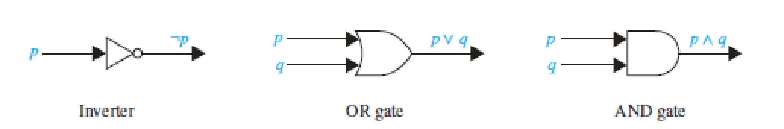
Logic Circuits
Propositional logic can be applied to the design of computer hardware
A logic circuit (or digital circuit) receives input signals p1, p2, … , pn, each a bit [either 0 (off) or 1 (on)], and produces output signals s1, s2, … , sn, each a bit.
The inverter, or NOT gate, takes an input bit p, and produces as output ¬p.
The OR gate takes two input signals p and q, each a bit, and produces as output the signal p ∨ q.
Finally, the AND gate takes two input signals p and q, each a bit, and produces as output the signal p ∧ q. We use combinations of these three basic gates to build more complicated circuits

Slide 7

Webpage Searching
Boolean searching is used to find Web pages
Example: Universities in New Mexico, looking for pages matching NEW AND MEXICO AND UNIVERSITIES. The results of this search will include those pages that contain the three words NEW, MEXICO, and UNIVERSITIES.
( This will include all of the pages of interest, together with others such as a page about new universities in Mexico)

Slide 8
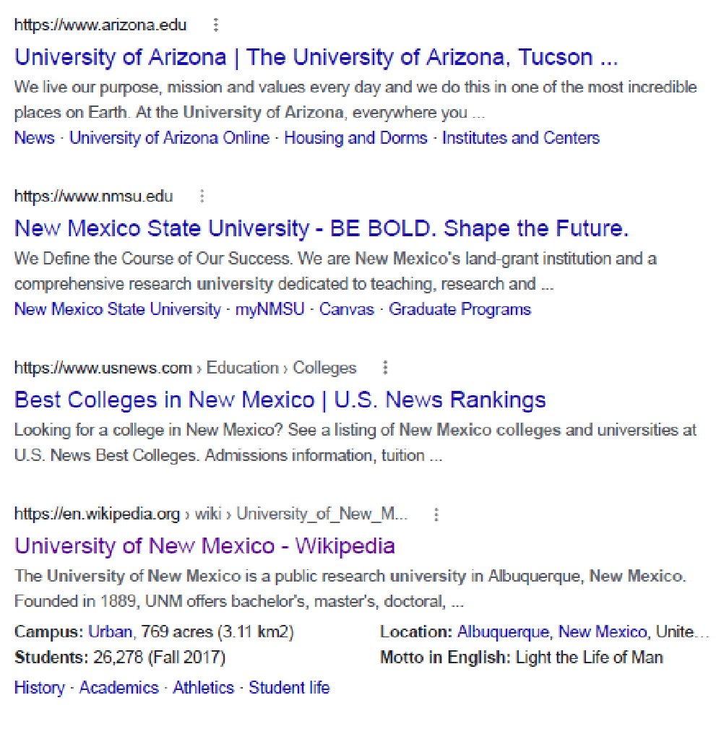
Webpage Searching
To find pages that deal with universities in New Mexico or Arizona,
we can search for pages matching (NEW AND MEXICO OR ARIZONA) AND UNIVERSITIES.
Note: Here the AND operator takes precedence over the OR operator. The results of this search will include all pages that contain the word UNIVERSITIES and either both the words NEW and MEXICO or the word ARIZONA

Slide 9
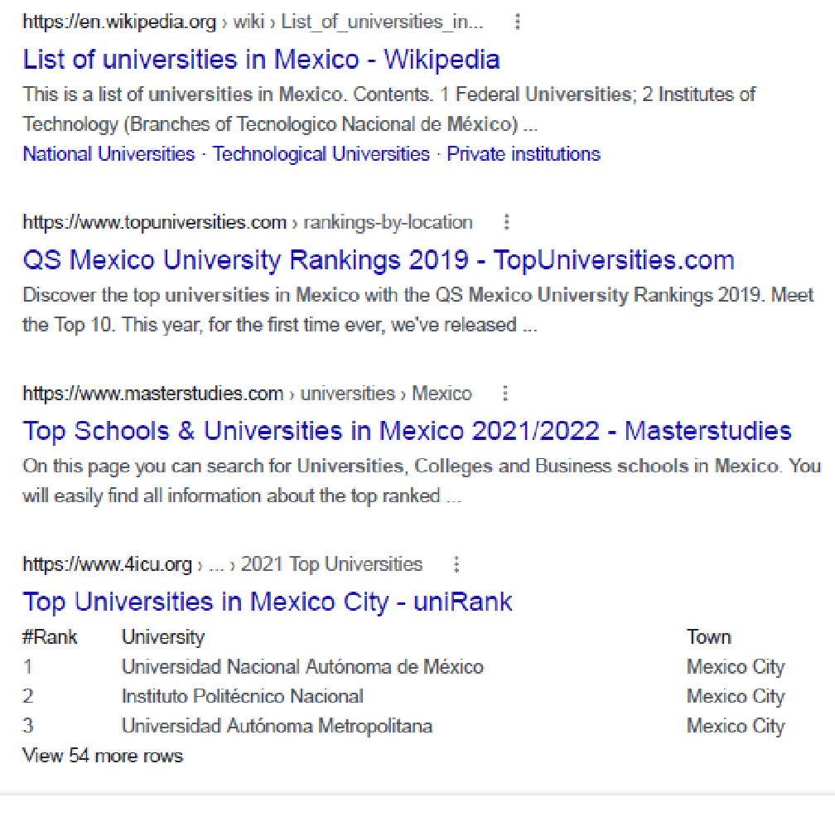
Web Search
Web pages that deal with universities in Mexico (and not New Mexico), first look for pages matching MEXICO AND UNIVERSITIES, but the results of this search will include pages about universities in New Mexico, as well as universities in Mexico,
It might be better to search for pages matching (MEXICO AND UNIVERSITIES) NOT NEW. The results of this search include pages that contain both the words MEXICO and UNIVERSITIES but do not contain the word NEW.
(In Google, and many other search engines, the word “NOT” is replaced by the symbol “-”. In Google, the terms used for this last search would be MEXICO UNIVERSITIES -NEW.)

Slide 10
END

